Slide 1


Slide 2


Why StethoMan??
StethoMan:
1- Stethoscope
2- Manager
StethocopeManager

Slide 3
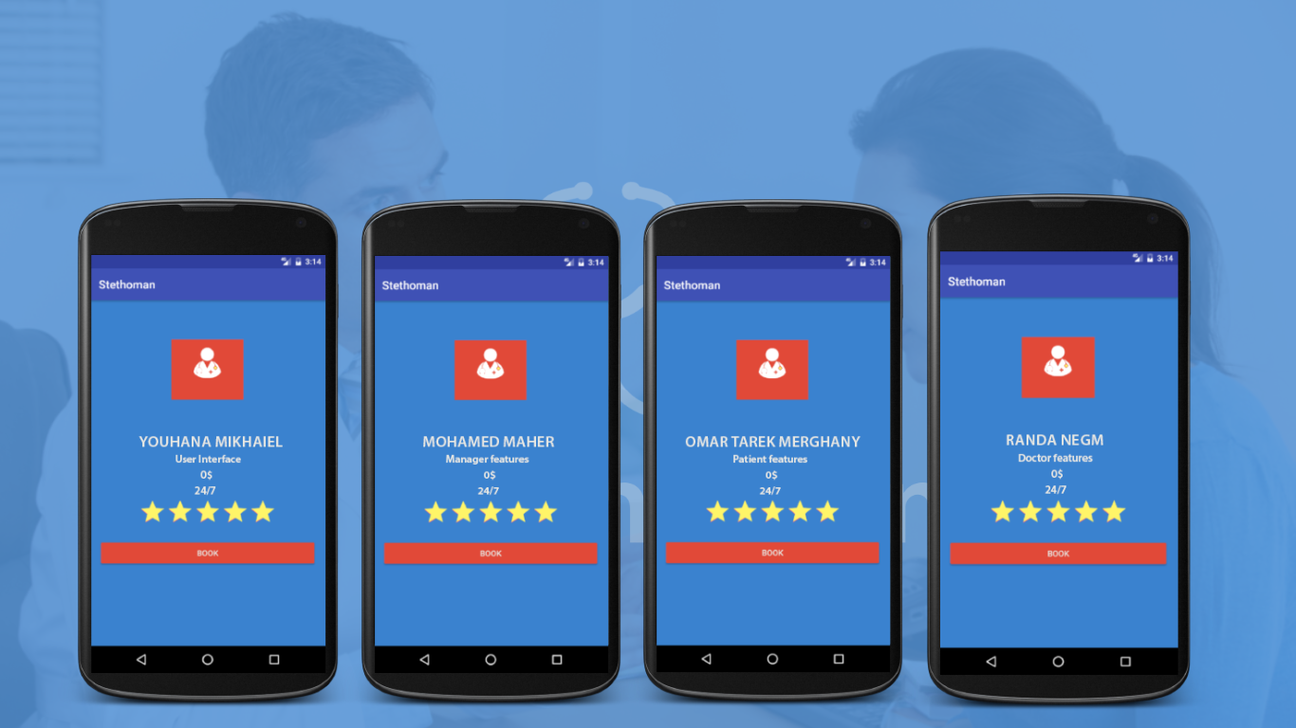
Team roles

Slide 4



Purpose and scope

Slide 5
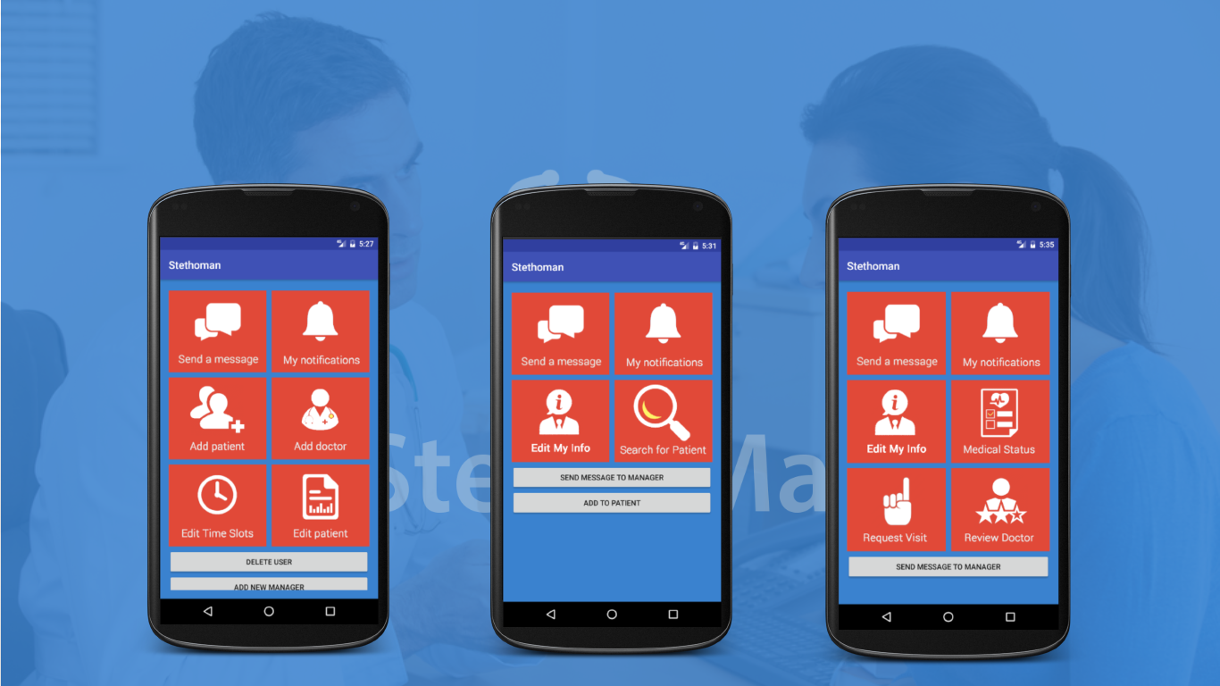
Software main features

Slide 6
Software main features
FINISHED
IN PROGRESS
Login
Add patient and doctor
Add medical record
Request visit
Review doctor
Send messages
View notifications
View medical records
Forget Password
Close time slot
View lab investigations
Alarms
Register as in waiting list

Slide 7
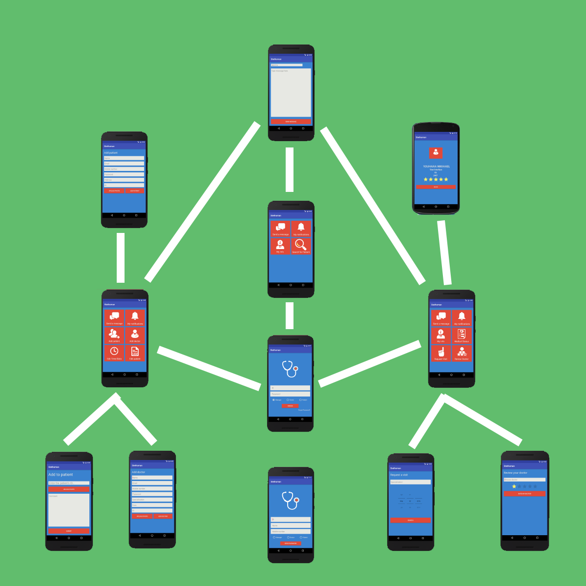
Main Components
Class diagram
Entity relationship diagram
User Interface

Slide 8
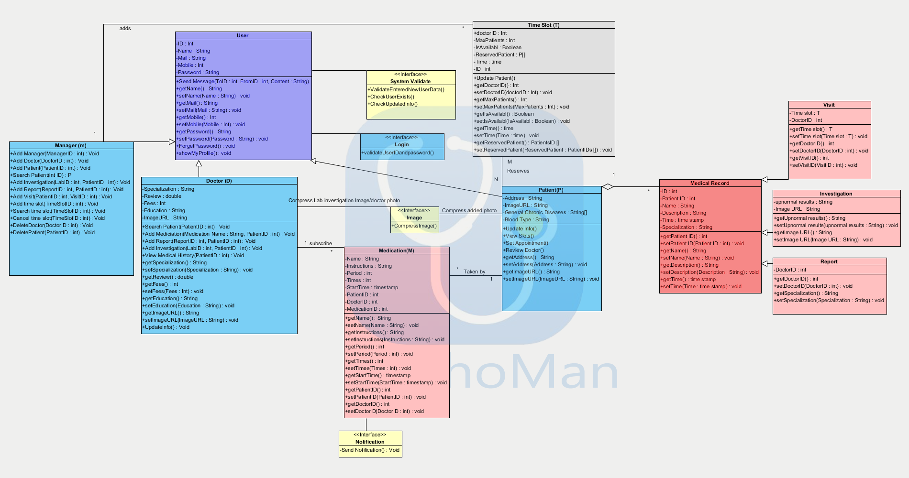
Class diagram

Slide 9
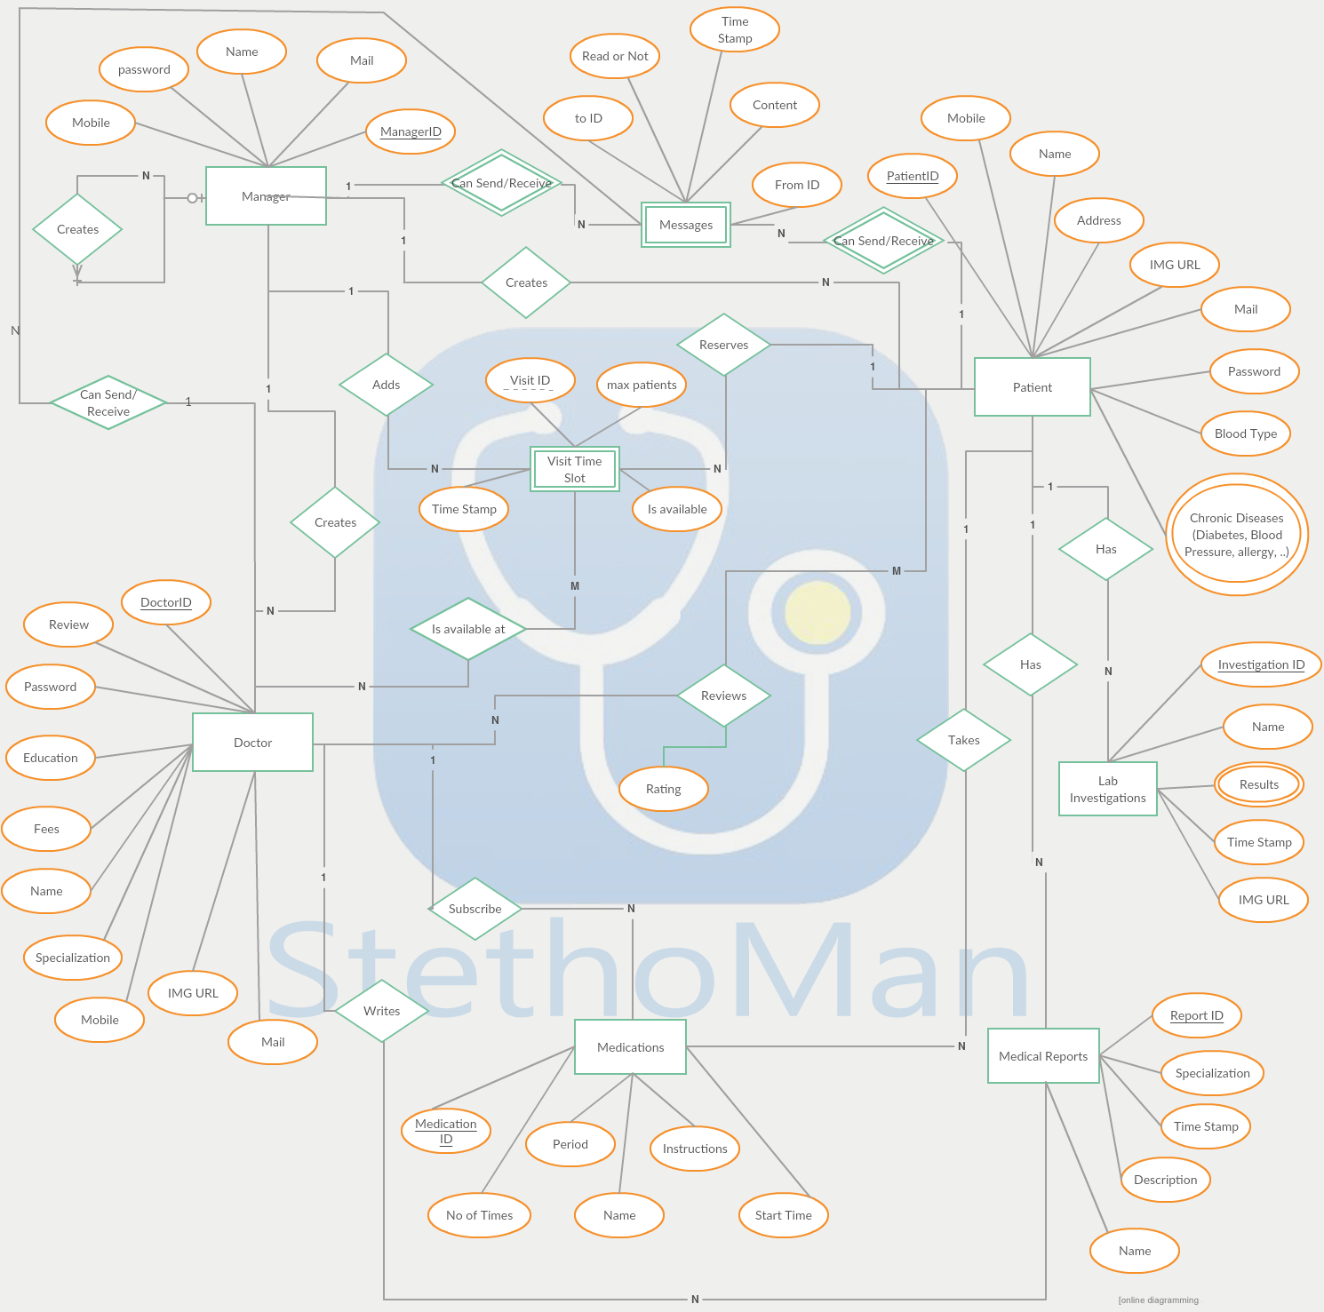
Database Design

Slide 10

User Interface (Color palette + fonts)
Roboto
Sans Sherif

Slide 11
User Interface

Slide 12
Way of communication
Github
Google drive
On campus

Slide 13

Difficulties
Technical: learning android – connection with database
Financial: paid server
Organization: guidelines to be followed

Slide 14

Thank you!!

